Slide 1
1
2
3
AI personalised learning/assessment
Immersive
learning
ChatGPT

Slide 2
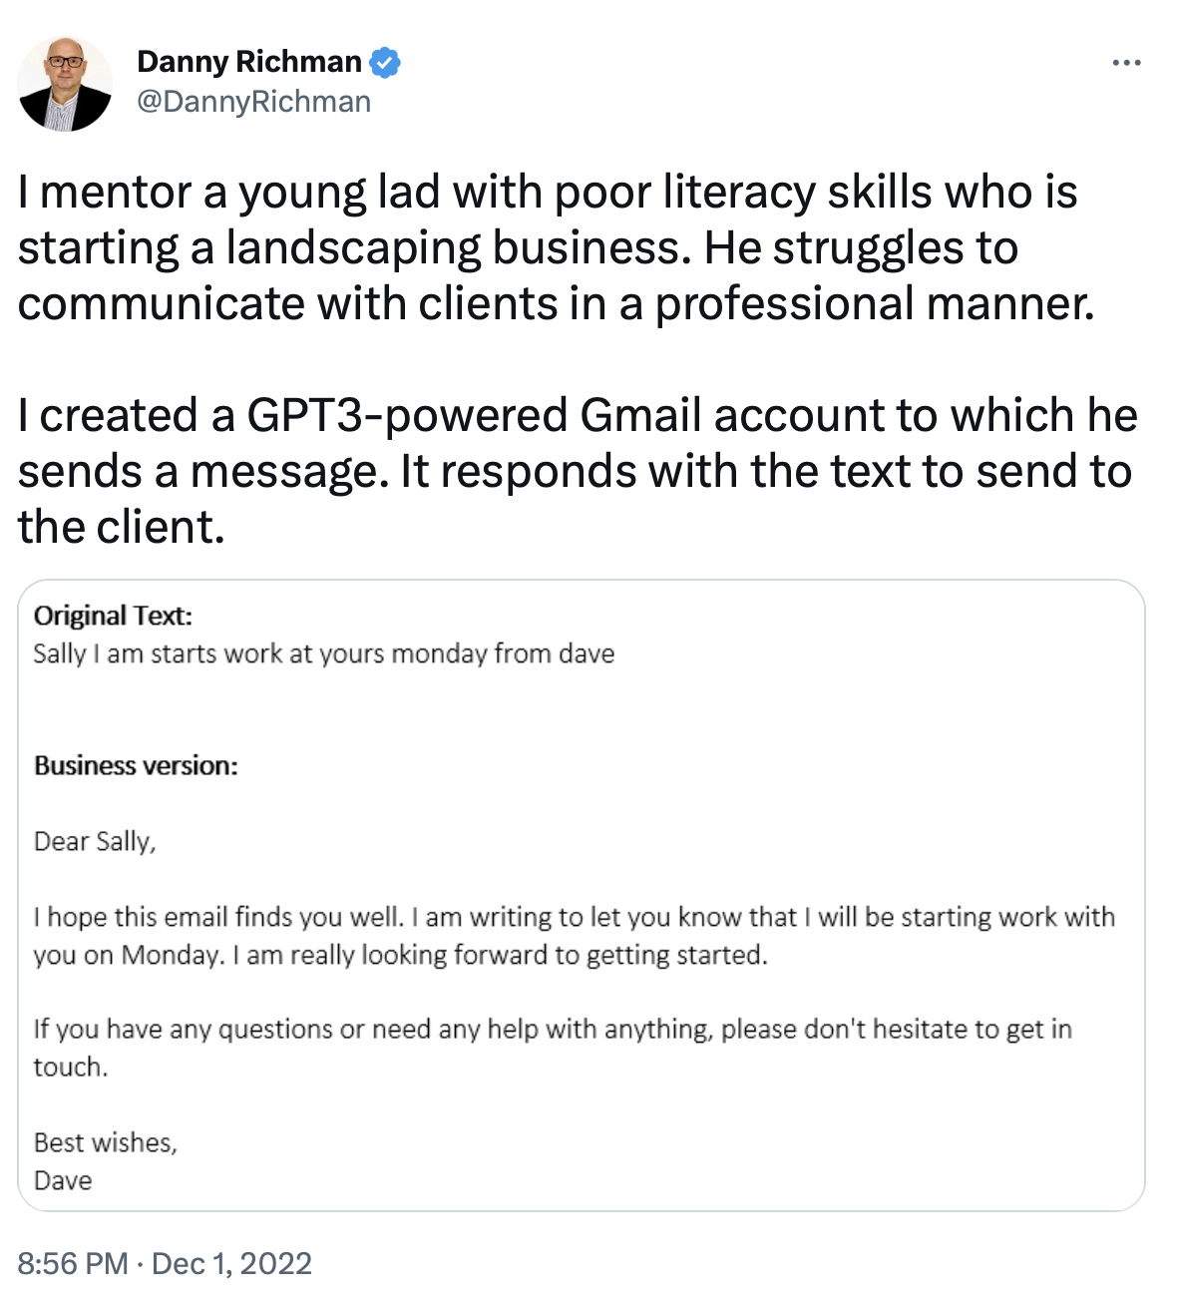
ChatGPT
1 December 2022
The first time I heard about GPT technology – in a short twitter thread from a tech consultant based in the UK

Slide 3
ChatGPT
Launched 30 November
Campus Morning Mail – 7 Dec
multiple examples start being shared on social media
clear that, at a minimum, it will transform written assessment practices and the teaching of IT coding
“academics have generated responses to exam queries that they say would result in full marks if submitted by an undergraduate, and programmers have used the tool to solve coding challenges in obscure programming languages in a matter of seconds”

Slide 4
ChatGPT
What is it?
a large language model (LLM) created by analysing BILLIONS of sentences of text from the internet
“machines that have ingested an internet’s worth of data, weighed up the relationships between things, and are able to generate content that appears to be new and original”
the auto-complete function in your email or SMS offers you suggestions based on the last word you typed, while ChatGPT draws on all the BILLIONS of sentences it’s been trained on, filters them and produces coherent responses to what you type

Slide 5
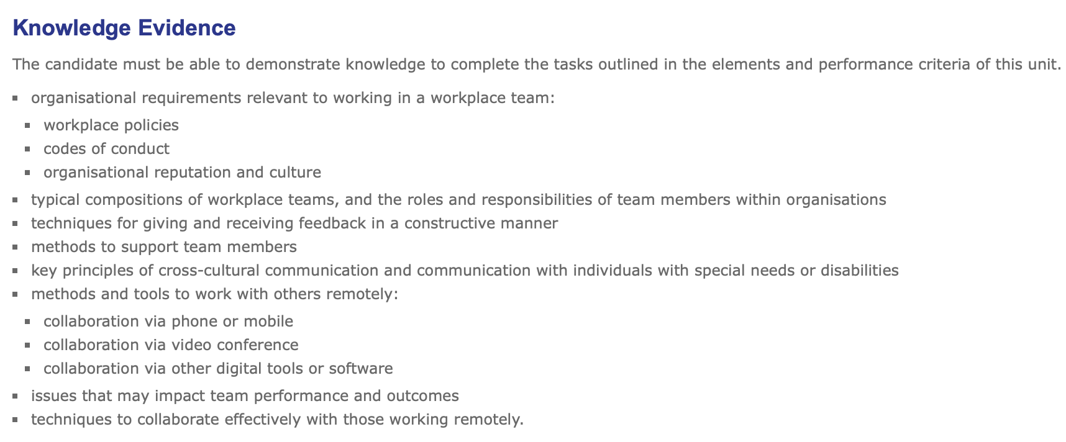
What does it mean for VET?
BSB - Business Services 3,323 RTOs with BSB units on scope

Slide 6
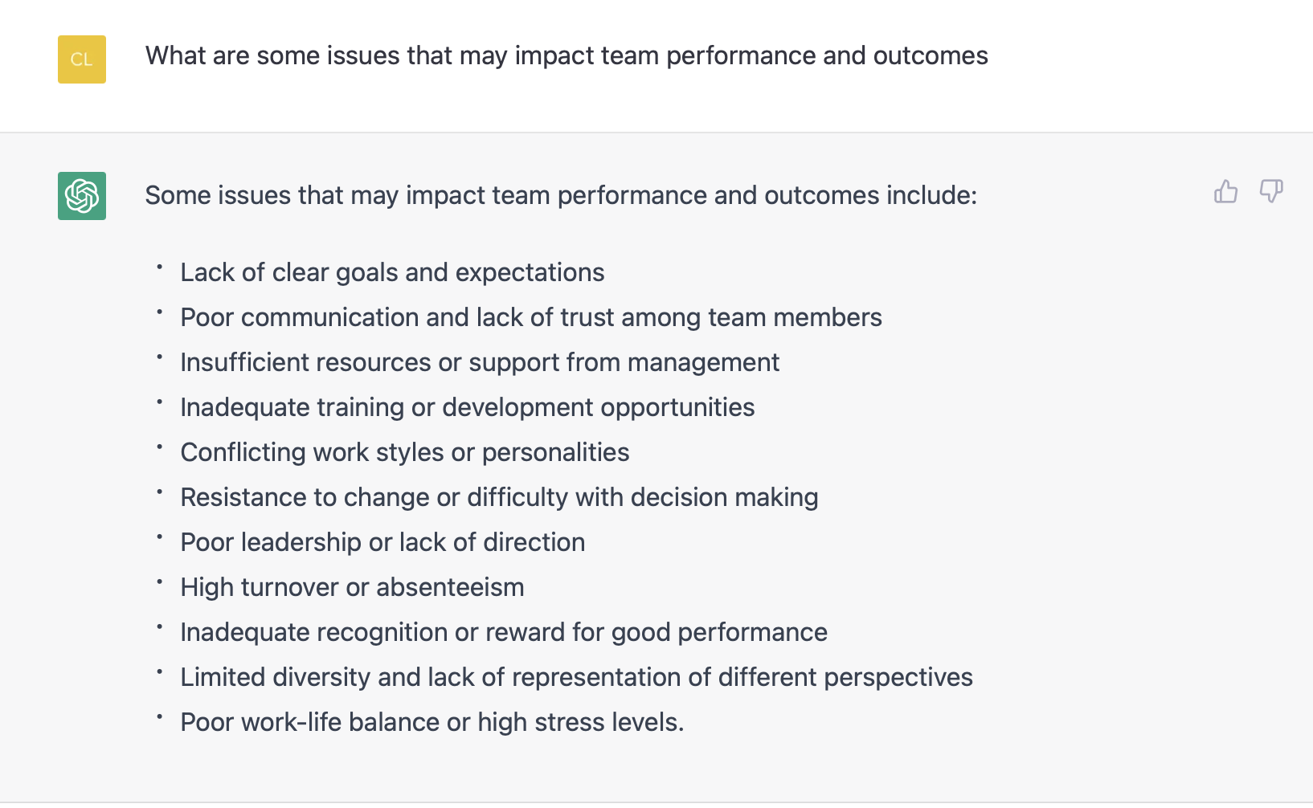

Slide 7
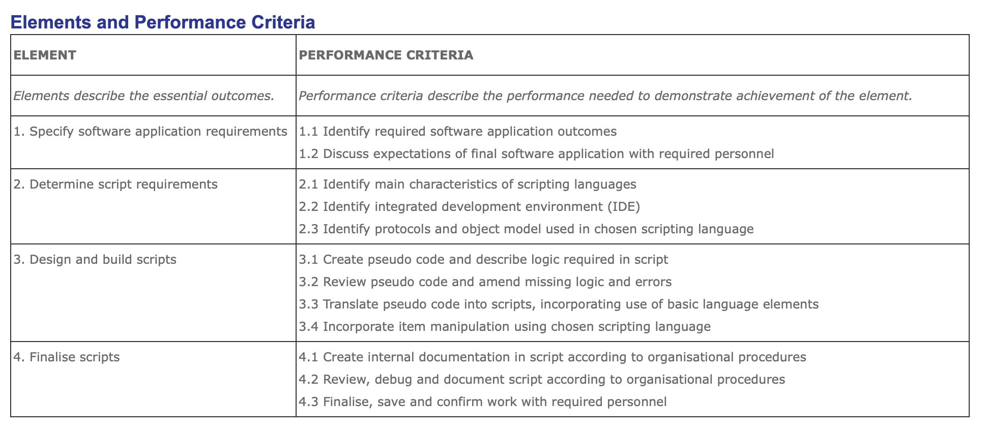
What does it mean for VET?
ICT – Information and Communications Technology

Slide 8
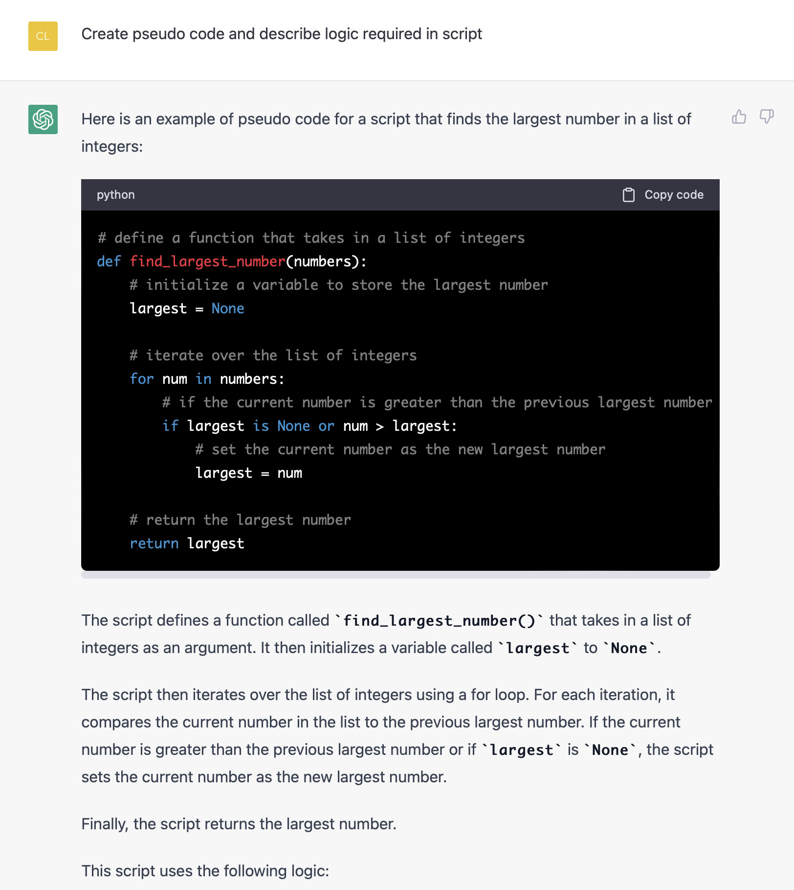

Slide 9
ChatGPT assessment issues
What’s needed?
no more written essays
no more powerpoint presentations
no more summaries, proposals, plans or alternative written responses as assessment tasks
more authentic assessment
not pencil and paper tests
think carefully about data privacy and ethical issues in using ‘ChatGPT detection’ services
if you’re incorporating ChatGPT into your teaching and learning practices – will it remain freely available/what are the equity issues?

Slide 10
Broader VET issues
AI/ChatGPT changing jobs
architects, furniture and interior designers
business & government data collection & processing
coding
customer service agents
developing fitness plans
editing
game creation
journalism
language translation
lawyers/paralegals
marketing, digital marketing
online coaching
teaching (developing lesson plans)
writing novels
https://www.autodesk.com

Slide 11
Personalised learning & assessment
AI to accelerate learning, increase student engagement, reduce teacher workload, target student interventions
RPL in real time
‘competency based’ not ‘time-based’ progression
https://www.century.tech

Slide 12
Immersive learning (AR/VR)

Slide 14
Immersive learning (AR/VR)

Slide 15
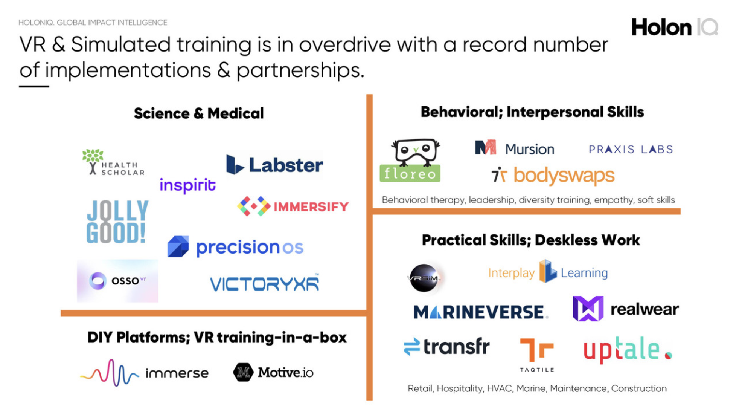
Immersive learning (AR/VR)

